Slide 1




DISNEY+HOTSTAR DATA ANALYSIS

Slide 2
Skills take away From This Project
Data visualization and storytelling
Data cleaning and preprocessing
Exploratory Data Analysis (EDA)
Using Tableau/Power BI for creating visualizations
Analytical thinking and deriving insights from data
Domain
Media and Entertainment

Slide 3
Problem Statement
Provide an in-depth analysis and visualization of a movie dataset to uncover insights and trends. This includes understanding the distribution of movies by genre, running times, release years, age ratings, and other attributes.

Slide 4
Business Use Cases
Content Strategy: Streaming platforms can use the analysis to understand which genres are most popular and plan their content strategy accordingly
Drama is the most popular genre having 1,236 movie released between 2001 and 2020 having highest run time of about 22,888.72 hours. Drama is the genre where all age group people watch the most.

Slide 5
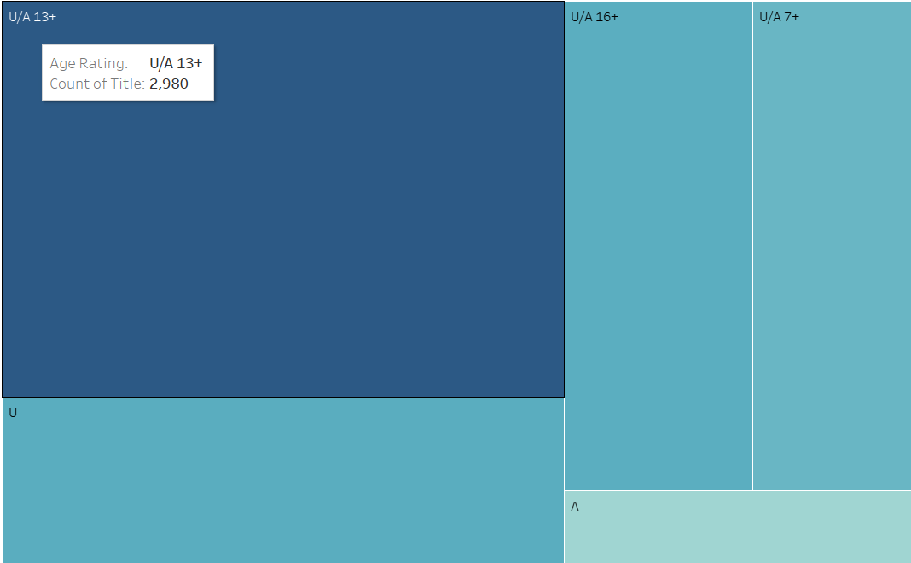
AUDIENCE SEGMENTATION
Insights into age ratings and running times can help platforms tailor their recommendations to different audience segments.
U/A 13+ - 2980 Movies
U - 1251 Movies
U/A 16+ - 1235 Movies
U/A 7+ - 1069 Movies
A - 338 Movies

Slide 6
SUMMARY
The historical analysis of movie trends provides valuable insights into the evolving landscape of the movie industry. By understanding past trends, stakeholders can make more informed decisions, enhancing their strategic planning and competitive edge in the market.

Slide 7
THANK YOU

